Slide 1
Amelia and Felipe
Data Exploration Assignment
TU85x
Instructions: delete slides as required but keep the section slides to orientate your tutor.

Slide 2
Top 250 Movies of all Time

Slide 3
Data Preparation and Cleaning

Slide 4
Data Prep – Data set
This data set looks at the top 250 IMDb movies ranging from the year 1951 to 2025 spanning over 20 genres. It explores variables such as:
Title – the official title of the movie
Year – the year it was released in
Rating – score given by IMDb out of 10
Votes – amount of user votes
Runtime – duration of the movie
expressed in minutes
Certificate – age rating (R, PG-13, PG)
Genre – genre of the movie, this can be one
or more
Gross income – worldwide box office revenue
in dollars

Slide 5
Data Quality Report – on the initial dataset
For each feature include the relevant characteristics
CATEGORICAL: Count, %Missing, Mode, Mode %, 2nd Mode, 2nd Mode %
CONTINUOUS: Count, %Missing, Min, Mean, Median, 1st Qrt, 3rd Qrt, Max, StDev
You can use the table format in the next silde

Slide 6
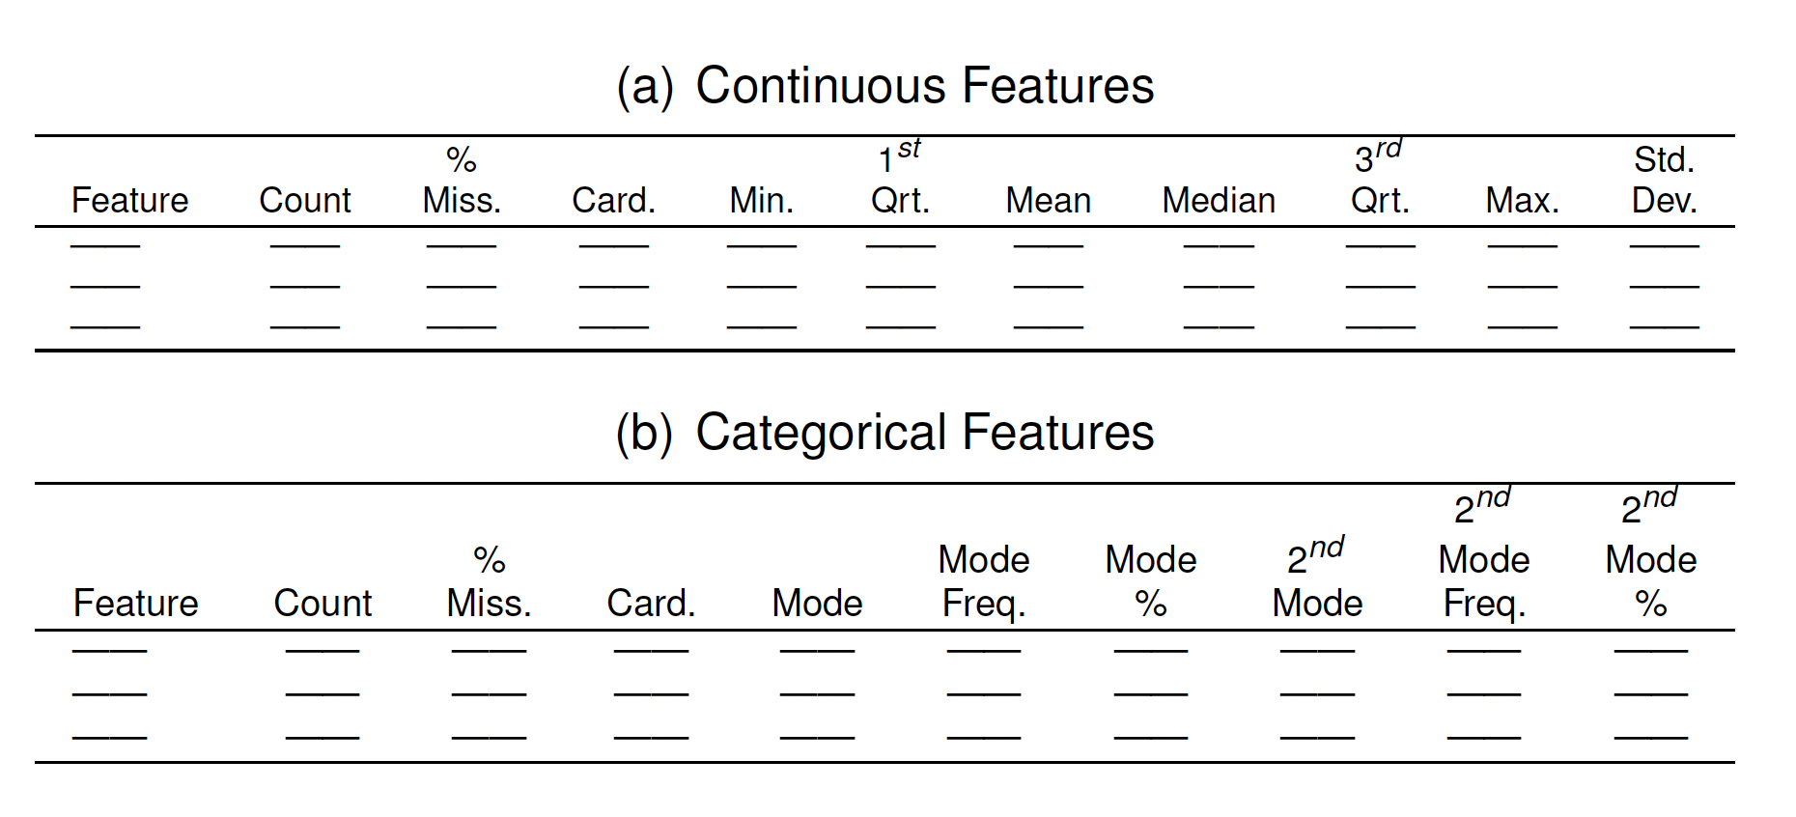
Data Quality report – on the initial dataset

Slide 7
Continuous
Feature | Count | %Missing | Card | Min | 1st Qrt. | Mean | Median | 3rd Qrt. | Max | Std Dev.
Rating
Votes
Runtime
Gross Income

Slide 8
Categorical
Feature | Count | %Missing | Card | Mode | Mode Freq | Mode % | 2nd Mode | 2nd Mode Freq | 2nd Mode %
Title
Year
Certificate
Genre

Slide 9
Data Prep – Outliers
Are there outliers in your dataset? Show evidence you’ve checked.
If there are outliers – how did you deal with them

Slide 10
Data Prep – Missing values
Are there missing values in your dataset? How are they represented? Show evidence you’ve checked.
If there are missing values – how did you deal with them?

Slide 11
Data Prep – Missing values
Are there missing values in your dataset? How are they represented? Show evidence you’ve checked.
If there are missing values – how did you deal with them?

Slide 12
Data Quality Report – after cleaning
Same as the previous slide but on the clean data instead of the initial data

Slide 13
Continuous
Feature | Count | %Missing | Card | Min | 1st Qrt. | Mean | Median | 3rd Qrt. | Max | Std Dev.
Rating
Votes
Runtime
Gross Income

Slide 14
Categorical
Feature | Count | %Missing | Card | Mode | Mode Freq | Mode % | 2nd Mode | 2nd Mode Freq | 2nd Mode %
Title
Year
Certificate
Genre

Slide 15
Summary Visualisations

Slide 16
3. Comparative Analysis

Slide 17
<Compare a numeric variable across two groups>
Include your question, analysis you’ve done and relevant visualisations
For example: Who needs more sleep, older or younger people?

Slide 18
<Question 2:…>
Include your question, analysis you’ve done and relevant visualisations

Slide 19
<Question 3: …>
Include your question, analysis you’ve done and relevant visualisations

Slide 20
4. Conclusions

Slide 21
Conclusions

Slide 22
References

